Slide 1
Analog Circuits and Systems
Prof. K Radhakrishna Rao
Lecture 12:
Static Characteristics of Feedback Systems

Slide 2
Review
Feedback
Negative feedback and positive feedback
Desensitization in negative feedback systems
Inversion function
Feedback output follows the input
Error tends to zero as loop-gain tends to infinity
Voltage follower, current follower, phase follower, frequency follower
Square rooter from squarer, FM detector from FM generator, D to A converter from A to D converter,

Slide 3
Offset in Feedback Systems
represents the forward transfer function of the system
If there is an offset at the output

Slide 4
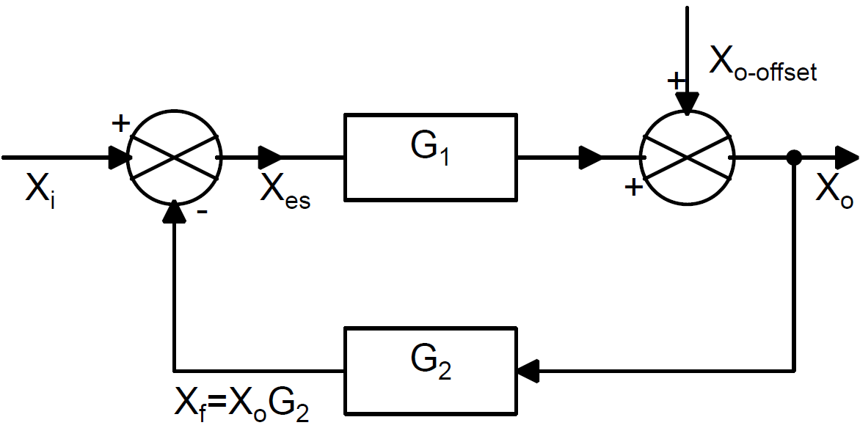
Negative feedback system with output offset
Offset at the output is reduced by (1+ Loop Gain)
Output offset can be compensated by suitably offsetting the input to the feedback system

Slide 5
Non-linearity
Nonlinearities
Saturation
Input-output relationships of G₁ and G₂ are nonlinear
Most common non-linearity is Saturation and it is odd-symmetric in nature
When the output is saturated the feedback loop gets broken
The dynamic range of input signal X_{i} over which the feedback loop is functional is called ‘lock range’ of the feedback system

Slide 6
Saturation
For small changes around a quiescent value the forward path gain function G₁ may be approximated as the slope around the operating point
Saturation may be modeled as tanh function
an even symmetric function

Slide 7
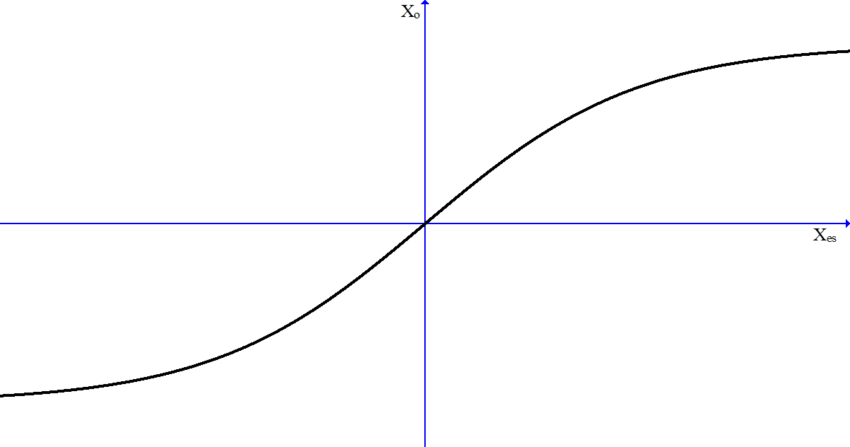
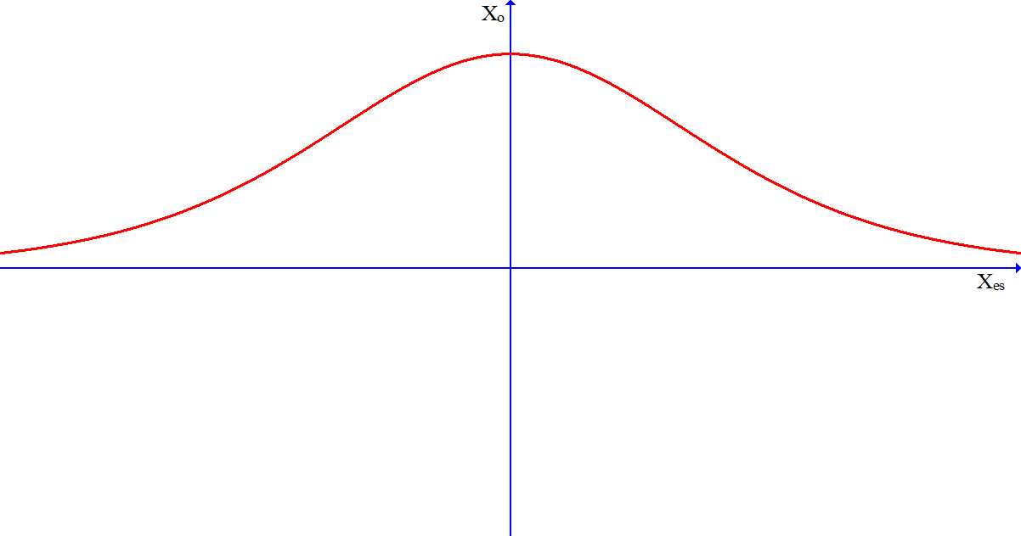
Saturation (contd.,)

Slide 8
Negative feedback and Saturation
It is assumed that G₂ is linear and there is no output offset
If saturation is simplified to include only the third order term

Slide 9
Negative feedback and Saturation (contd.,)
As long as the error introduced due to saturation is negligible
For all values of X_{i} for which the output does not approach saturation limits, i.e., the incremental loop gain is greater than say 10, the error is reduced by a factor of
When output is in saturation the loop gain becomes zero and the loop is broken

Slide 10
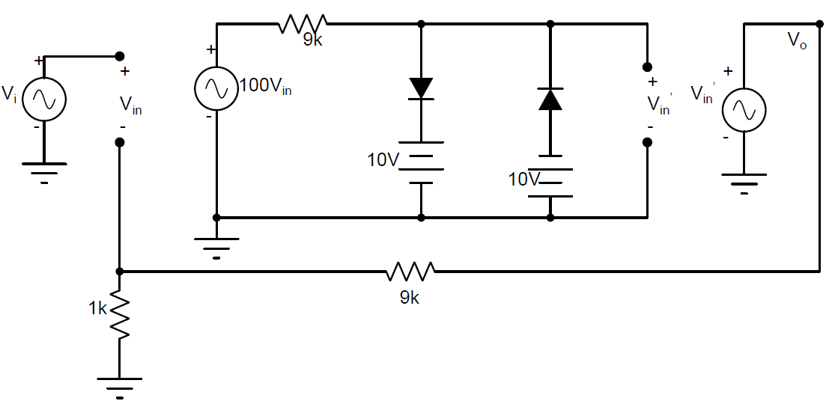
Example: Linear System
Gain = 10; G₂ = 1/10; G₁₀ = 100; System Saturates at +10 V

Slide 11
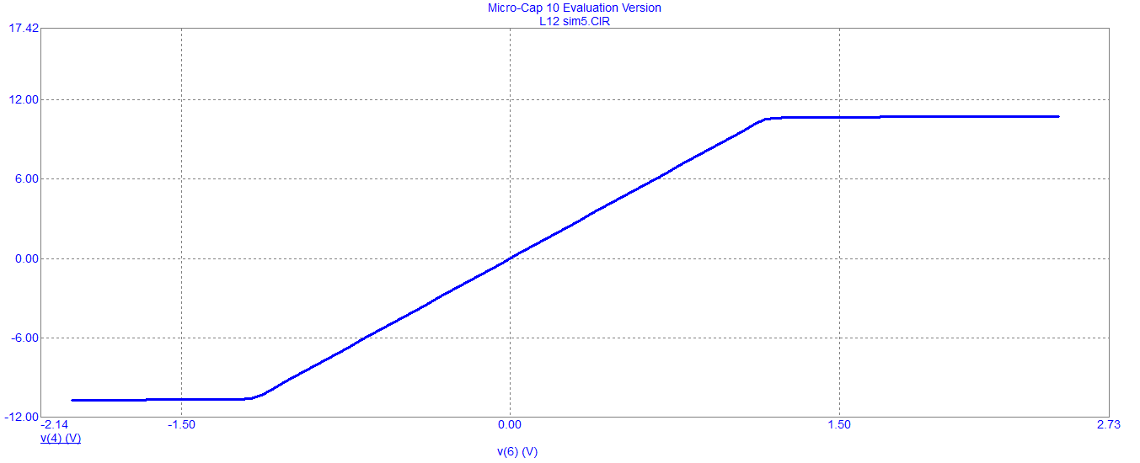
Simulation
Input limit to saturation = +(10/10) = +1 V

Slide 12
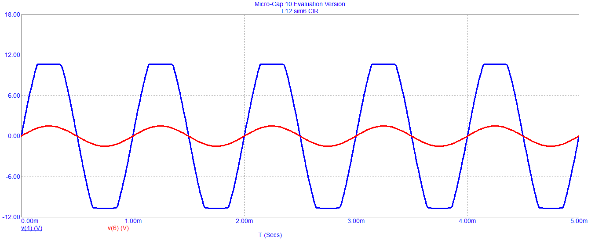
Simulation
For f = 1000 Hz
For input signal resulting in saturation

Slide 13
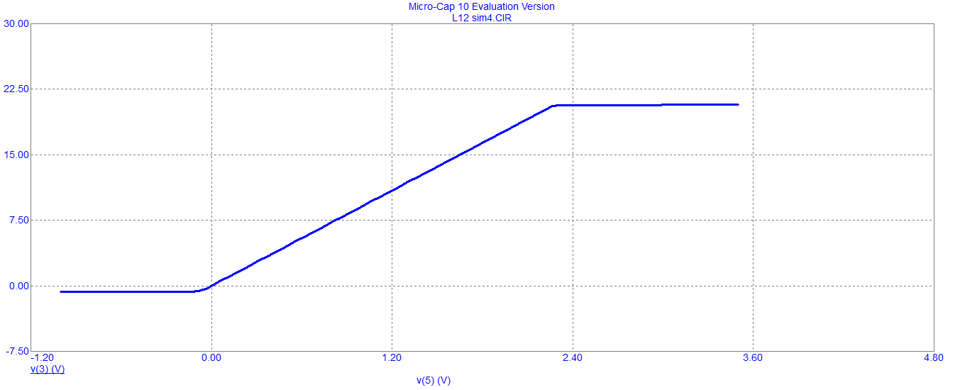
Example: Feedback System with Offset
Saturation points at 0 and 20
Lock range of the system is 0 – 2 V

Slide 14
Example
Piece-wise linear approximation to Nonlinear System
G₂ = 1
G₁ = 100 for
= 10 for
= 0 for
(Saturation)

Slide 15
Example (contd.,)

Slide 16
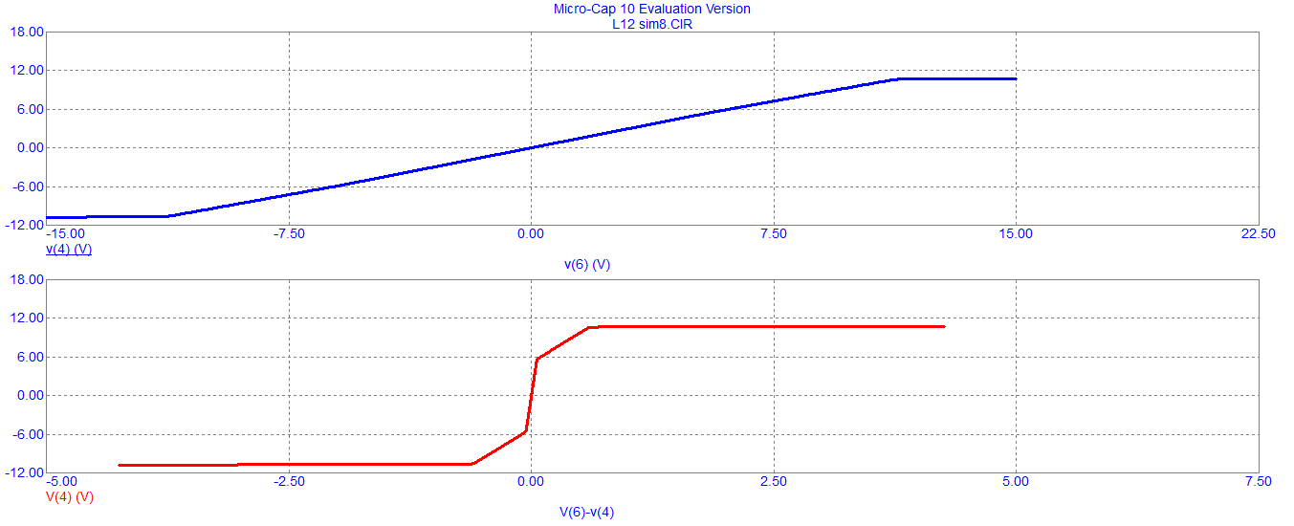
Simulation

Slide 17
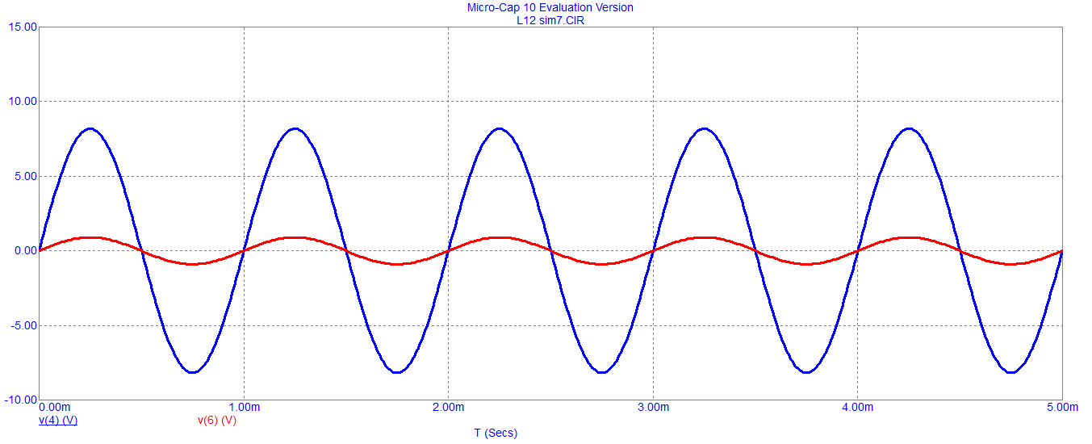
Simulation for low frequency inputs
For input signal not leading to saturation

Slide 18
Simulation for low frequency inputs (contd.,)
For input signal resulting in saturation

Slide 19
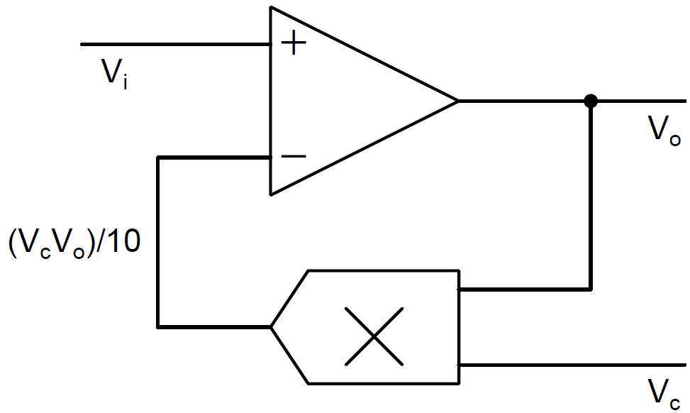
Lock Range: Divider
Multiplier is designed for inputs and outputs limited to + 10 V

Slide 20
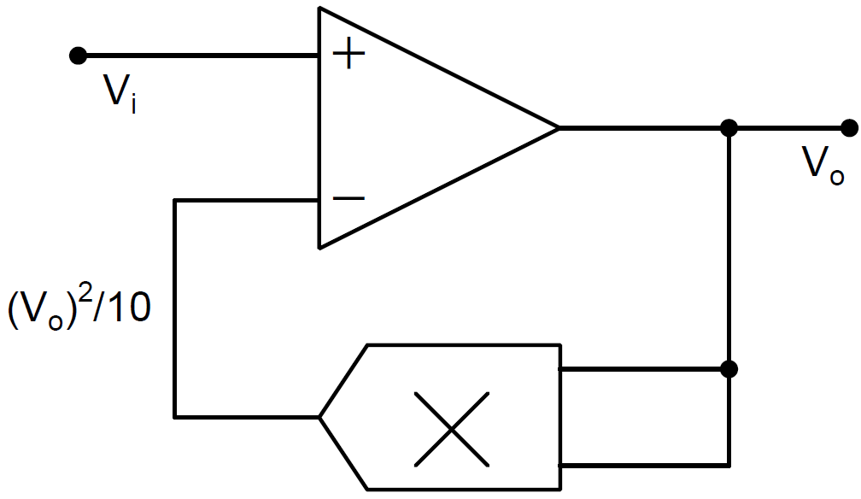
Lock Range: Square Rooter
As is always positive the lock range is given by 0 < V_{i} < 10

Slide 21
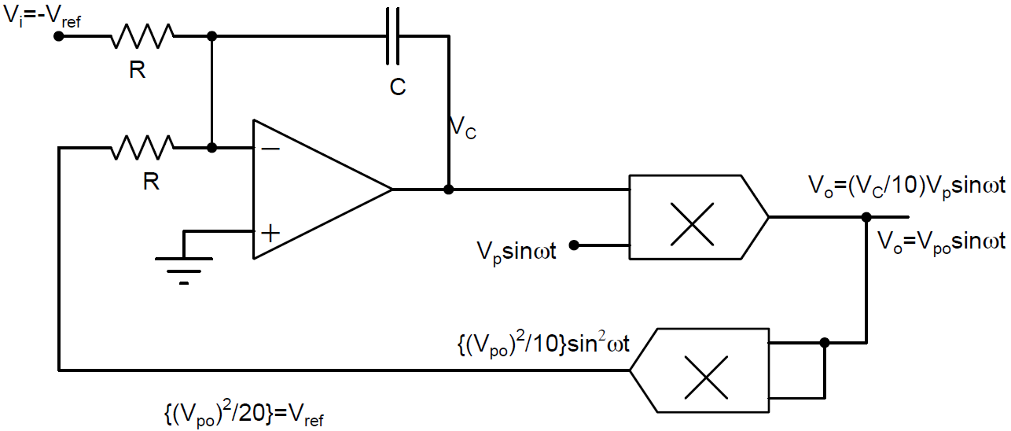
Lock Range: Automatic Gain Controller

Slide 22
Lock Range: Automatic Gain Controller (contd.,)
V_{po} remains constant irrespective of changes in V_{p,} but depends on V_{i}
V_{ref} has to remain positive for the loop to remain as negative feedback.
As multiplier output cannot be greater than 10 V; 0 < V_{ref} <10
Lock range =

Slide 23
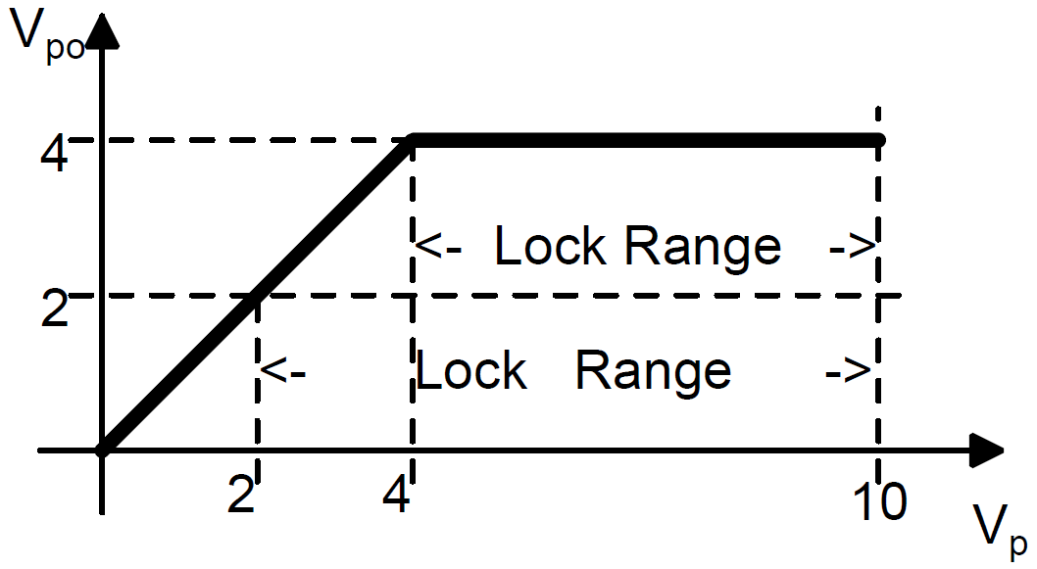
Lock Range: Automatic Gain Controller (contd.,)
For the output tracks the input to the multiplier

Slide 24
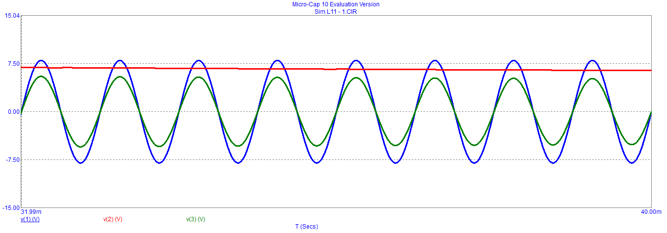
Simulation
In the lock range
V_{p} = 8V, V_{C} = 5V

Slide 25
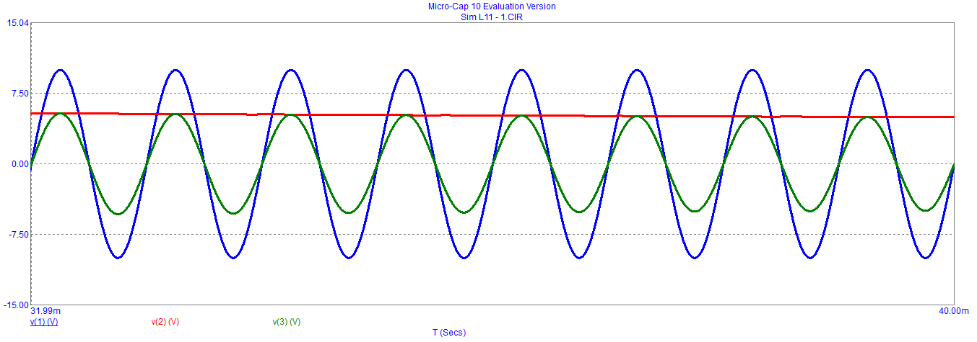
Simulation
In the lock range
V_{p} = 10V, V_{C} = 4V

Slide 26
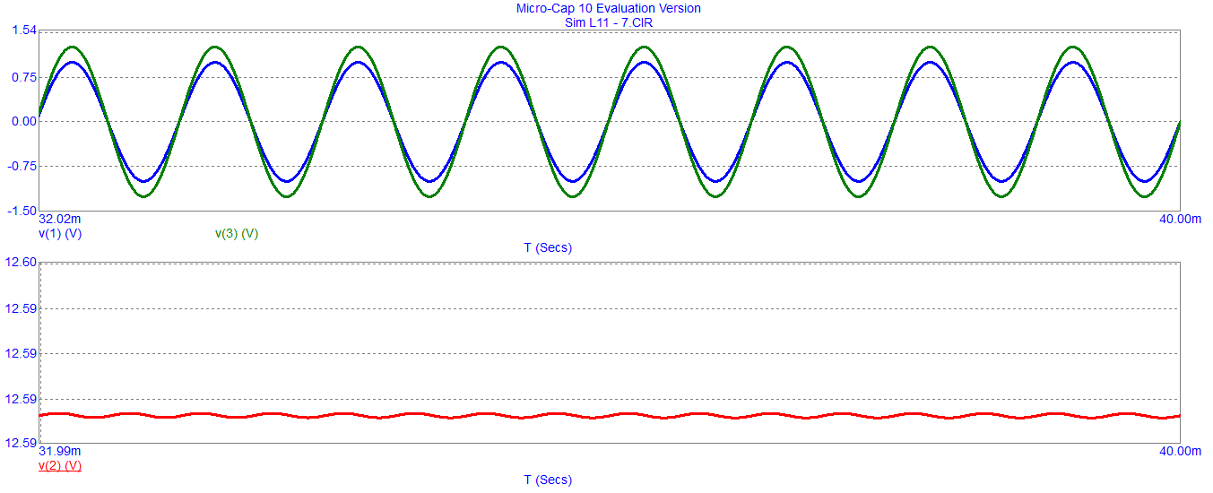
Simulation
Outside the lock range
V_{p} = 1V, V_{C} is Saturated

Slide 27
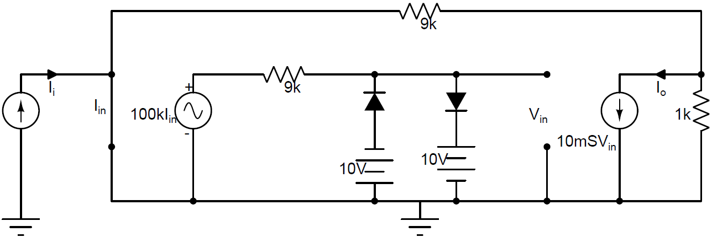
Lock Range: Current Amplifier
Trans-resistance amplifier cascaded with trans-conductance amplifier
G₁ = 100kΩ x 10mS =1000 and G₂ = 1/10
Output of Trans-resistance amplifier is limited to + 10V
Lock range of I_{i} is +10 mA

Slide 28
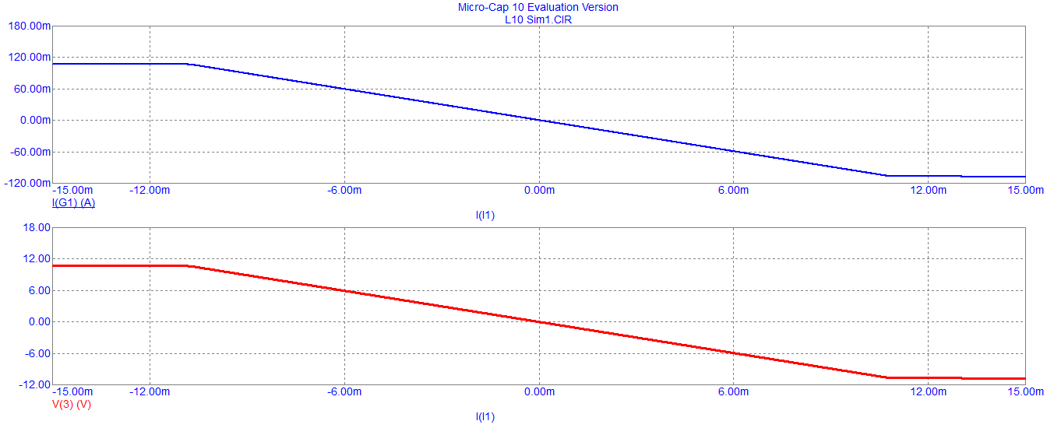
Simulation

Slide 29
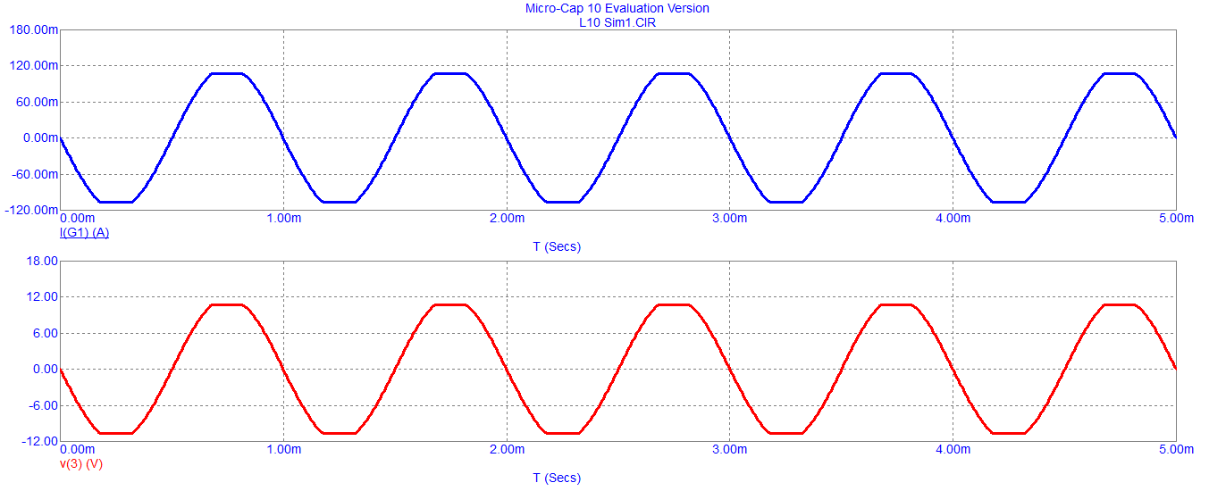
Simulation
For I_{i} = 12 sin ωt

Slide 30
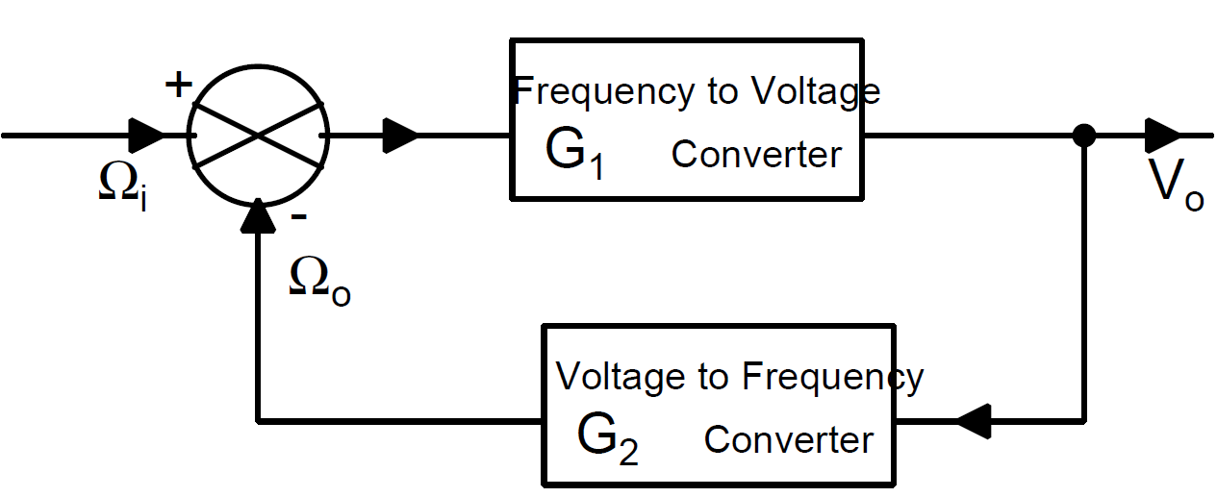
F-V in loop with V-F

Slide 31
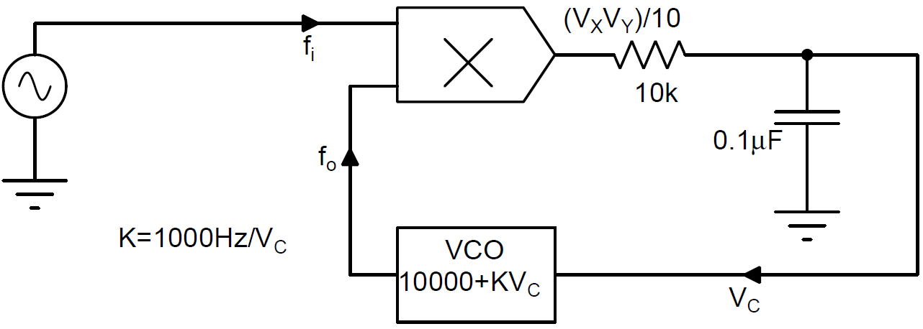
FLL – Lock Range

Slide 32
Distortion caused by non-linearity

Slide 33
Noise
Noise is any undesirable signal
Noise
may internally be generated in a system
can enter a system from external sources
Noise in electronics is broadly classified as
white noise (infinite bandwidth)
colored noise (narrow bandwidth)
shot noise (low frequency)
Drift in output offset

Slide 34
Conclusion
Static characteristic of negative feedback systems
Distortion reduction
Linearity
Noise reduction
Effect of saturation
Dynamic range of operation or lock range
Dynamic characteristic of feedback loop will be the topic of next lecture

